Slide 1
Limited Sonography 1st, 2nd, and 3rd Trimester
Serving Your Community

Slide 2
So happy to serve you as you serve others!
Presenter
Connie Ambrecht, CEO
RDMS, CMB, G&L Coach
2620 Regatta Dr 102
Las Vegas, NV 89128
702-925-8737
702-556-1101

Slide 3
Limited Definition
Discussing the AIUM Guideline

Slide 4
Applying the AIUM Definition
Review the wording
Share what stands out (highlight or underline)
Consider how it applies
How you message it to others is important
Your PMC
Notes:
Share what you know about the AIUM definition of a Limited Exam

Slide 5
Take aways from the AIUM
__________________________
__________________________
__________________________
__________________________
__________________________

Slide 6
What your consent says
Finding the following:
Location
Heartbeat w M-mode
Gestational age

Slide 7
First trimester
Not as easy as it looks

Slide 8
What do you include?
Midline long or sagittal
Adnexa; right and left
Complete uterus

Slide 9
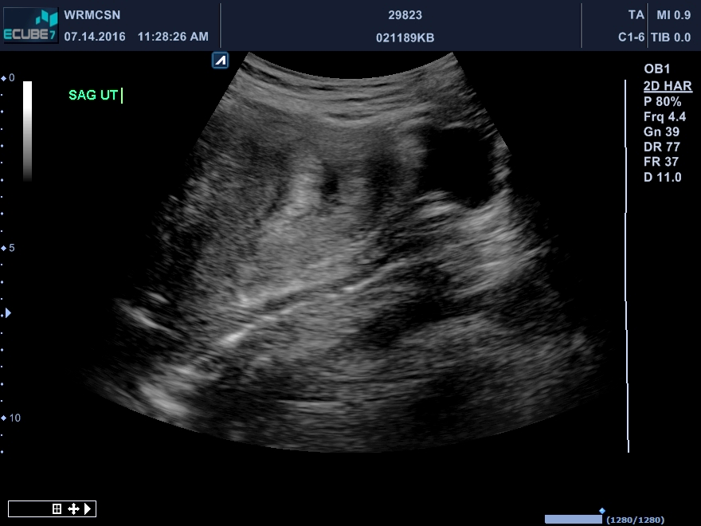

Slide 10
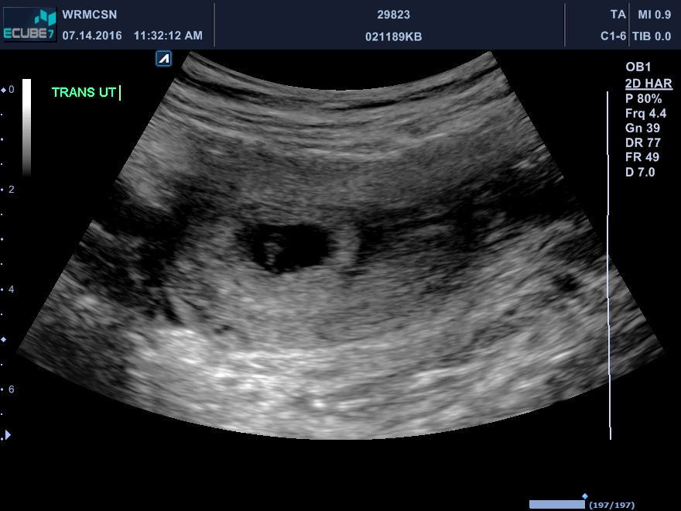

Slide 11
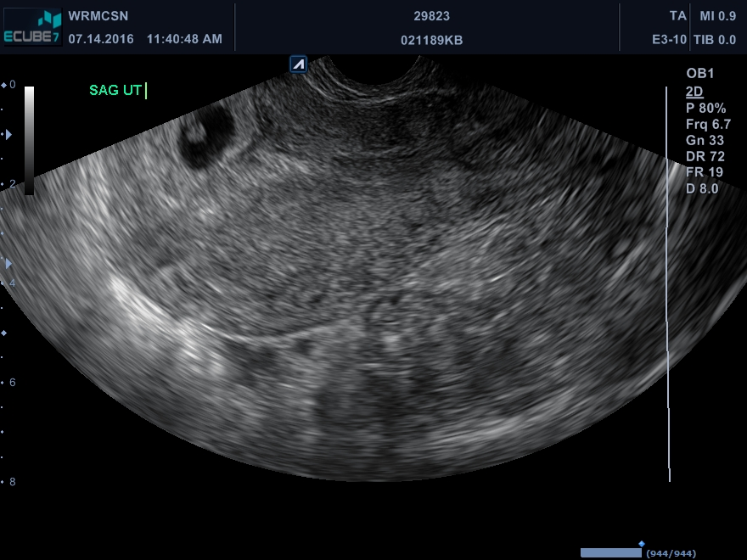

Slide 12
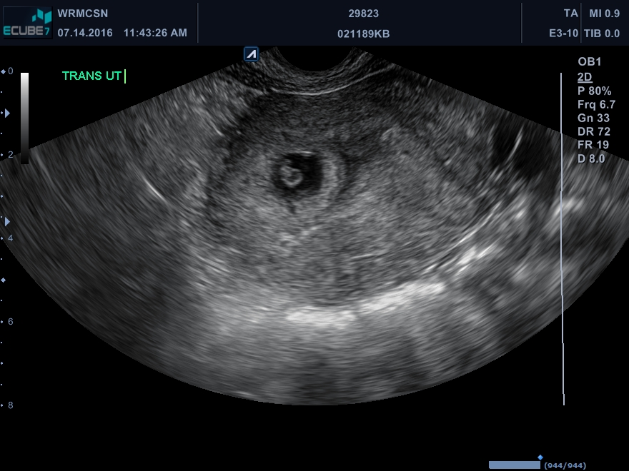

Slide 13
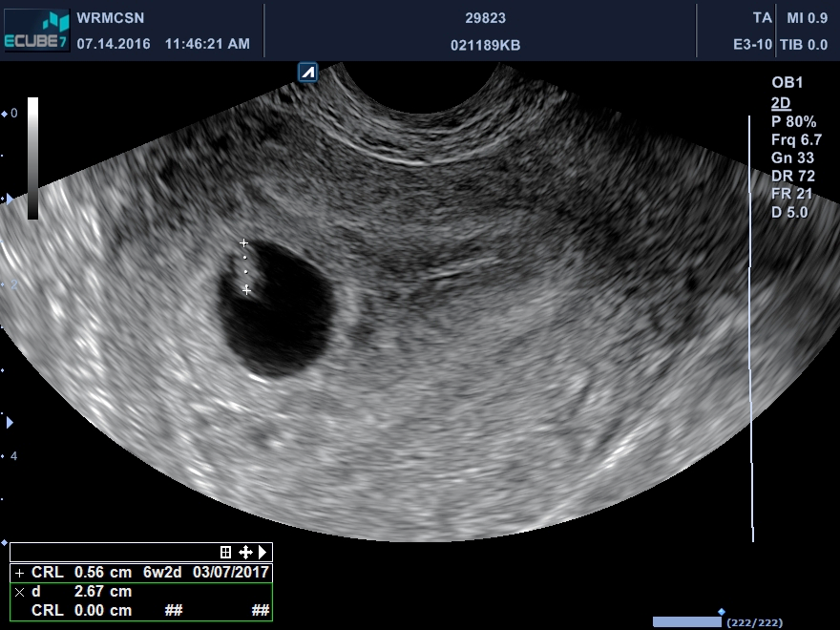

Slide 14
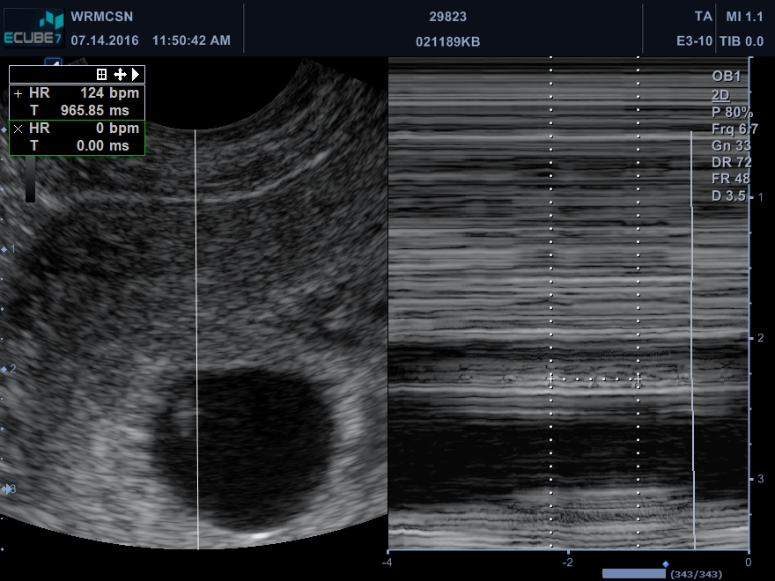

Slide 15
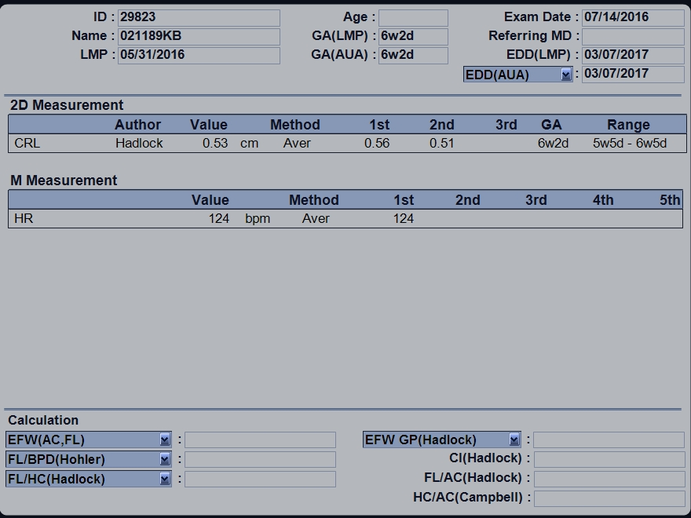

Slide 16
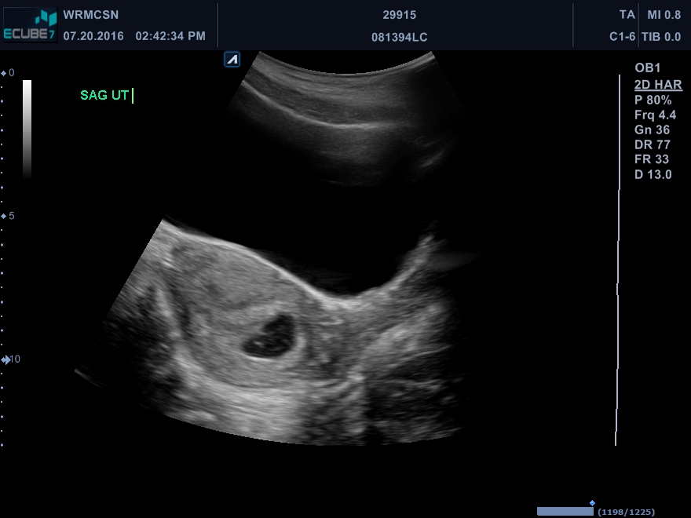

Slide 17
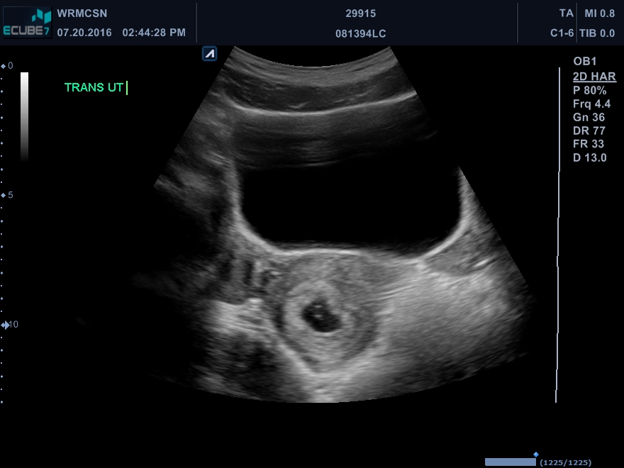

Slide 18
Take aways
Routine
Full bladder…even if you have to wait
Cervix image: Key to documenting IUP
Patient care
Standards in imaging
Images in chart; who needs what

Slide 19
2nd and 3rd Trimester
Patient care and imaging

Slide 20
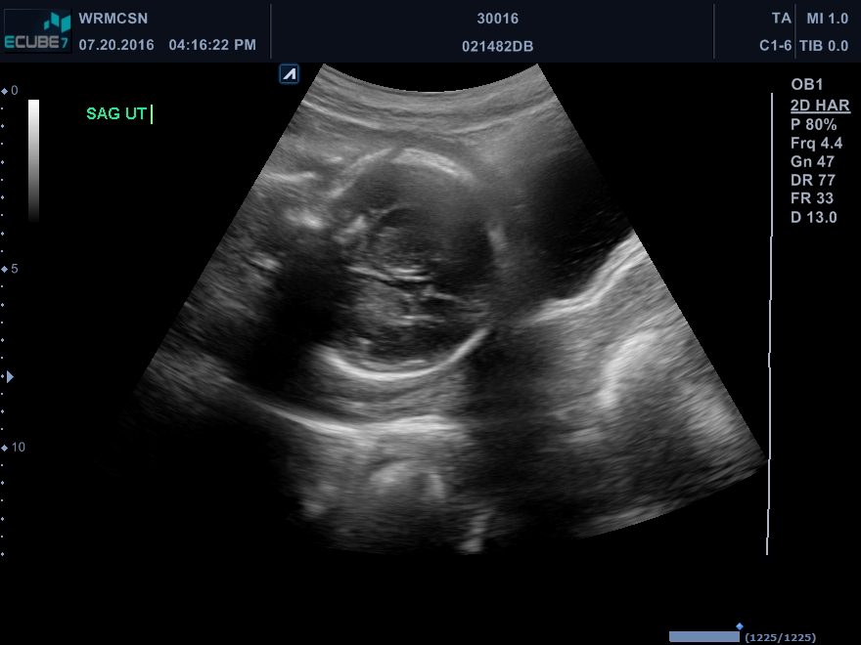

Slide 21
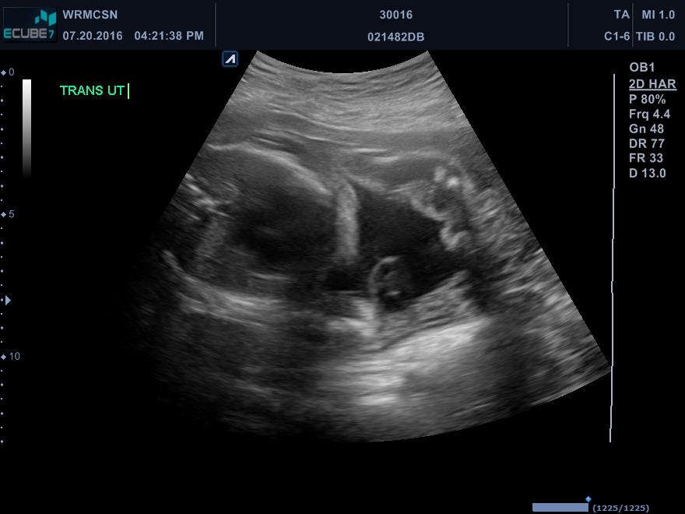

Slide 22
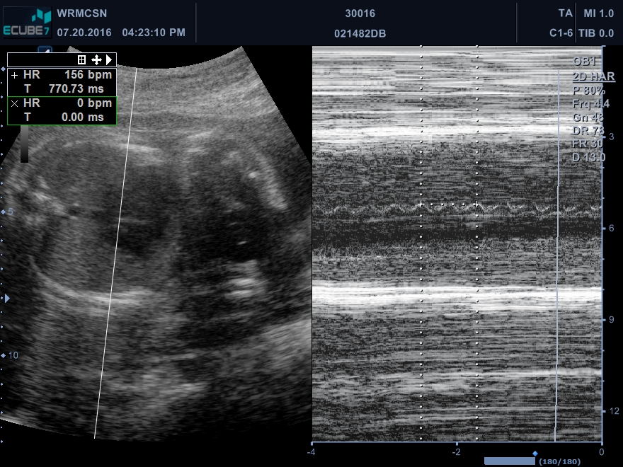

Slide 23
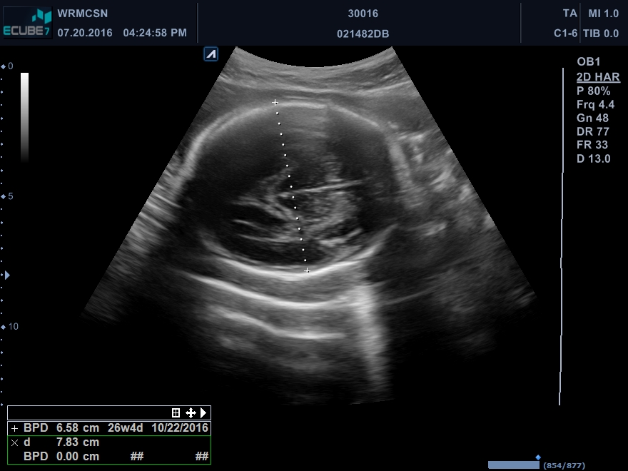

Slide 24
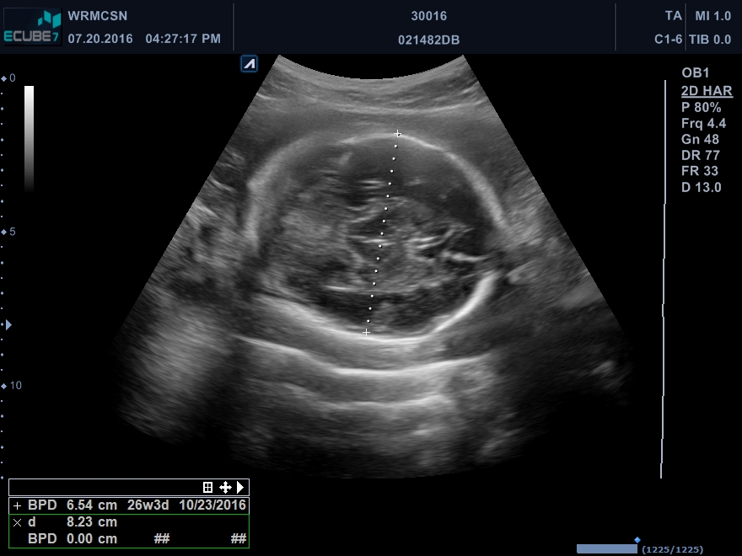

Slide 25
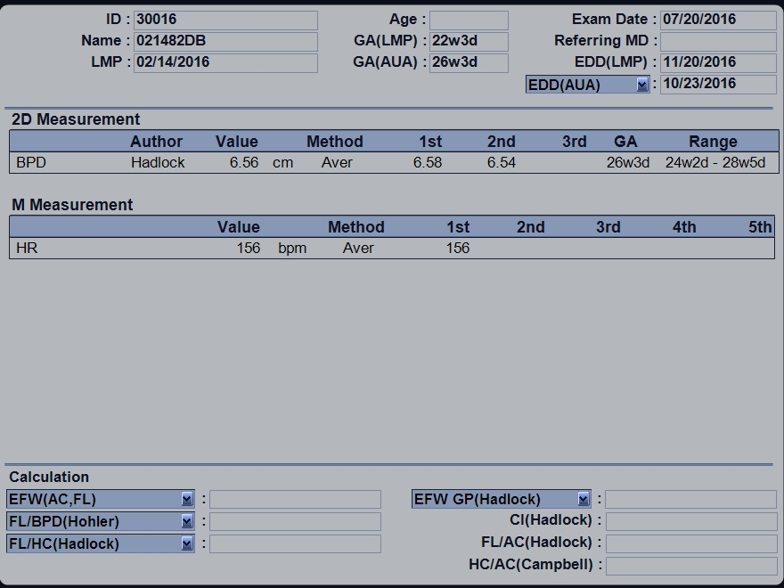

Slide 26
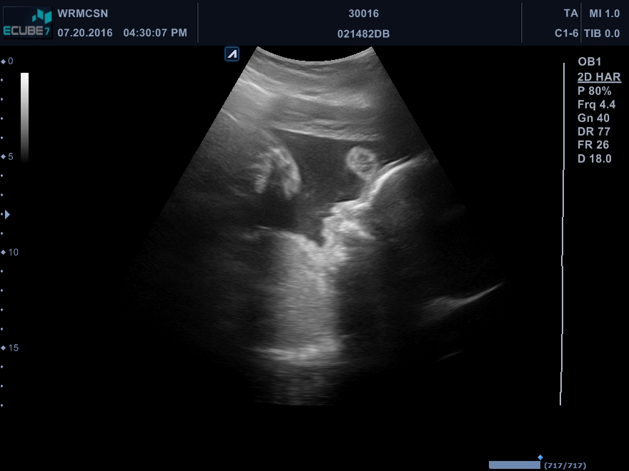

Slide 27
Take aways
Routine
How to message this to others
(Medical Director)
Skills
Remaining competent
Move away from the baby

Slide 28
Retroverted uterus
Is it me?

Slide 29
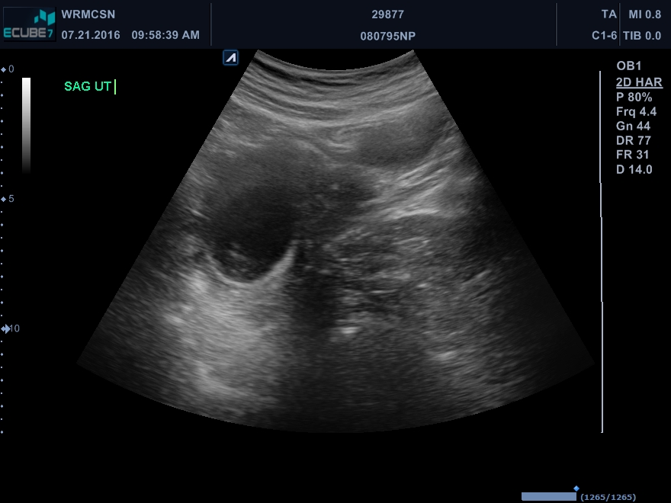

Slide 30
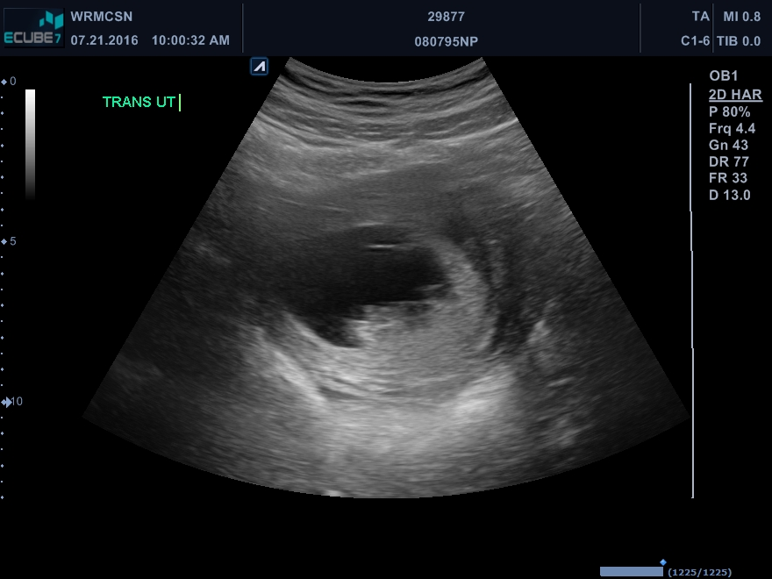

Slide 31
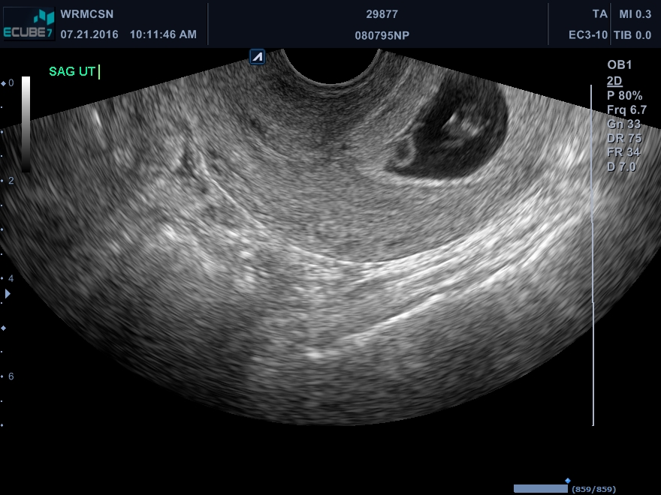

Slide 32
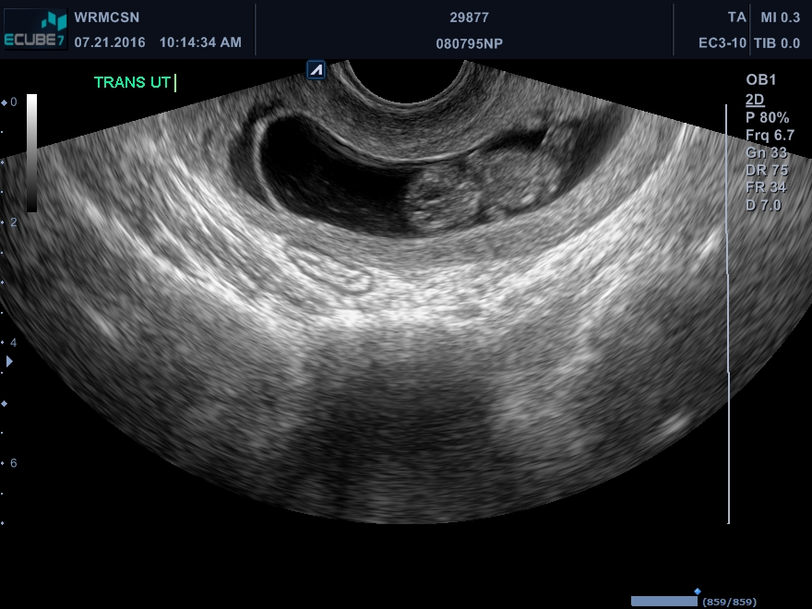

Slide 33
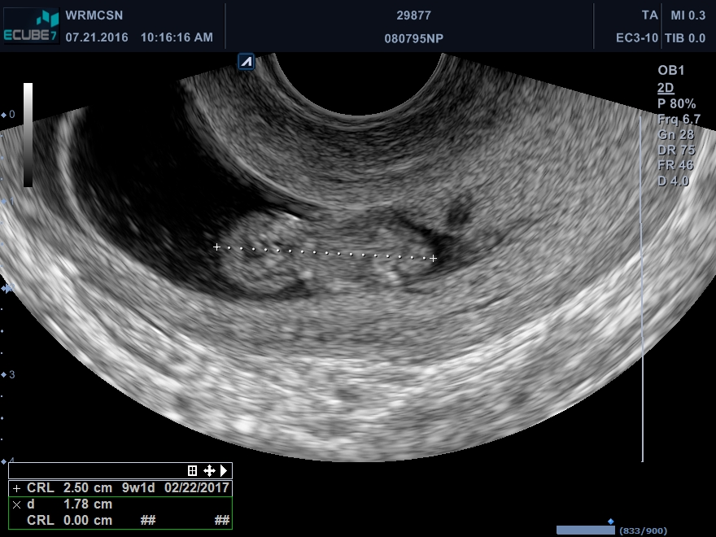

Slide 34
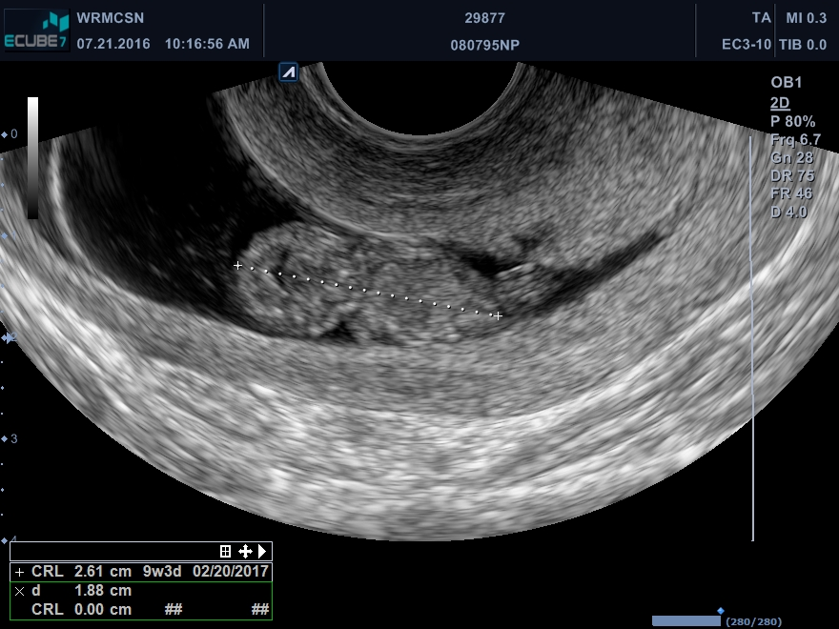

Slide 35
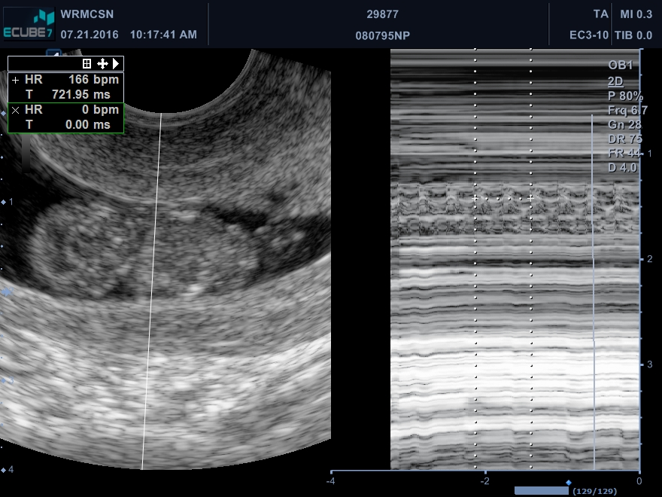

Slide 37
What your day really looks like
Always ready

Slide 38
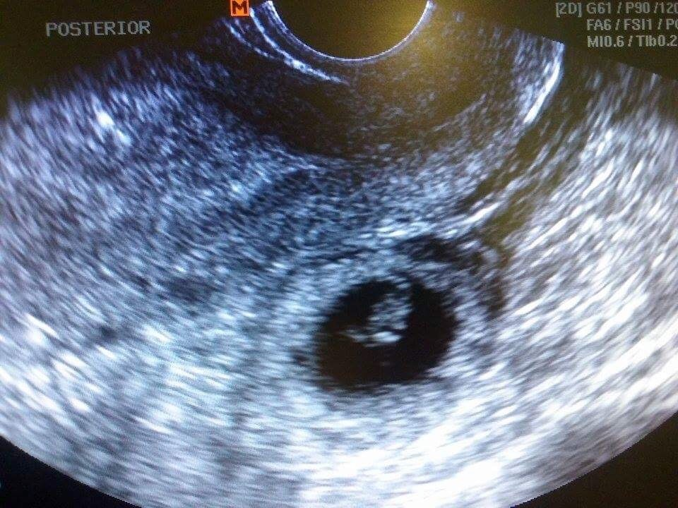

Slide 39
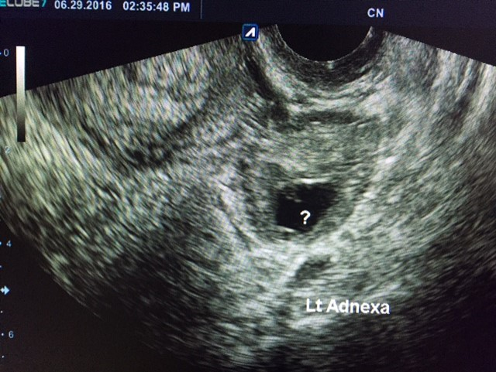

Slide 40
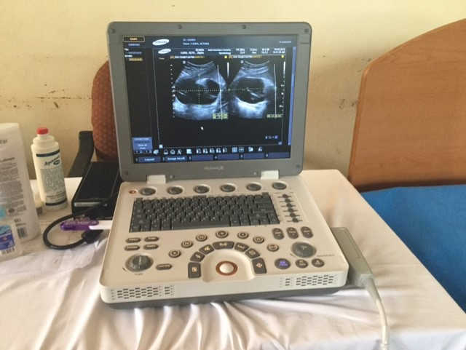

Slide 41
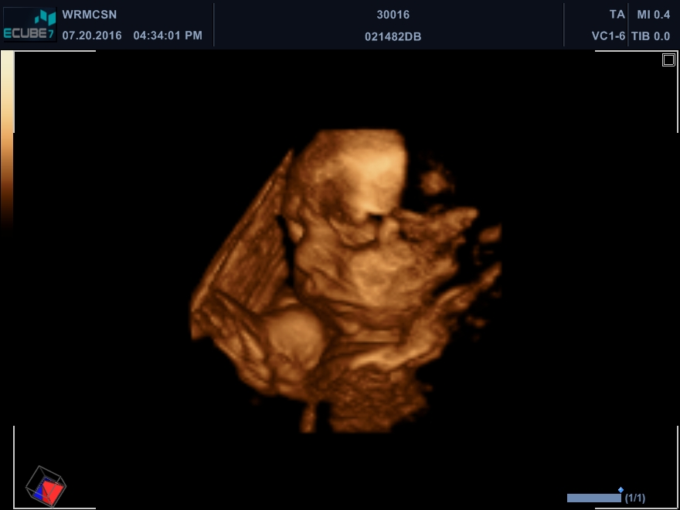

Slide 42
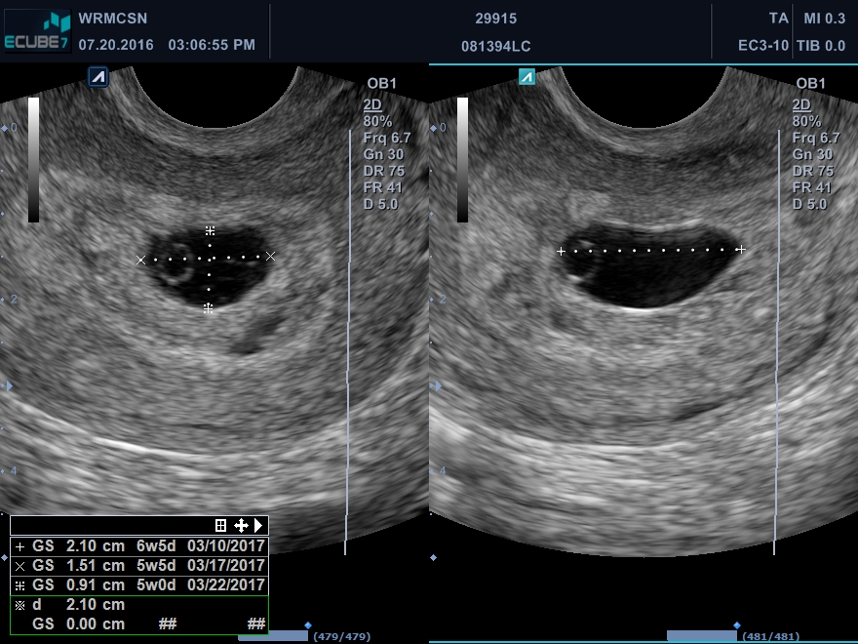

Slide 43
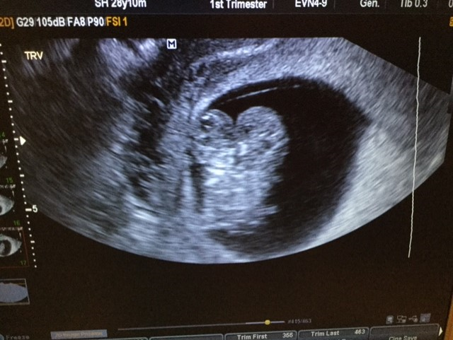

Slide 45
Thank you
Happy scanning!

